Slide 1
无约束场景下人体感知理解 报告人：金磊
SCHOOL OF ELECTRONIC ENGINEERING BUPT

Slide 2
目录
研究背景
UniParser 多人人体解析算法
单阶段人体姿态估计算法
人体姿态序列优化算法
后续研究
SCHOOL OF ELECTRONIC ENGINEERING BUPT

Slide 3
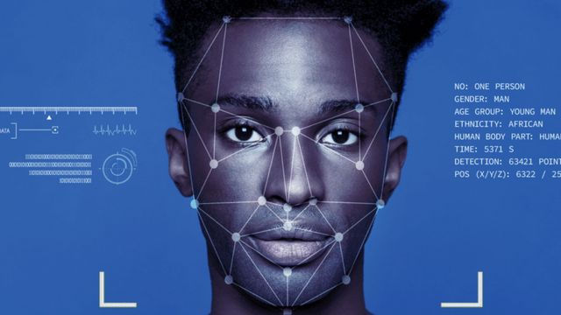
研究背景
无约束场景下人物图象/视频理解仍面临诸多挑战
SCHOOL OF ELECTRONIC ENGINEERING BUPT

Slide 4
研究背景
相关应用
无约束条件下人像目标智能感知一直都面临诸多内在与外在因素挑战
姿态
表情
遮挡
……
互遮挡
完全遮挡
长时遮挡
……
内在致变
外在诱变
人脸表观与形状之间复杂耦合变化
多个目标之间存在复杂交互和遮挡
性别
年龄
种族
……
光照
分辨率
模糊噪声
……
各种内部诱变因素之间错综关联
各种外部复杂对抗要素综合干扰
SCHOOL OF ELECTRONIC ENGINEERING BUPT

Slide 5
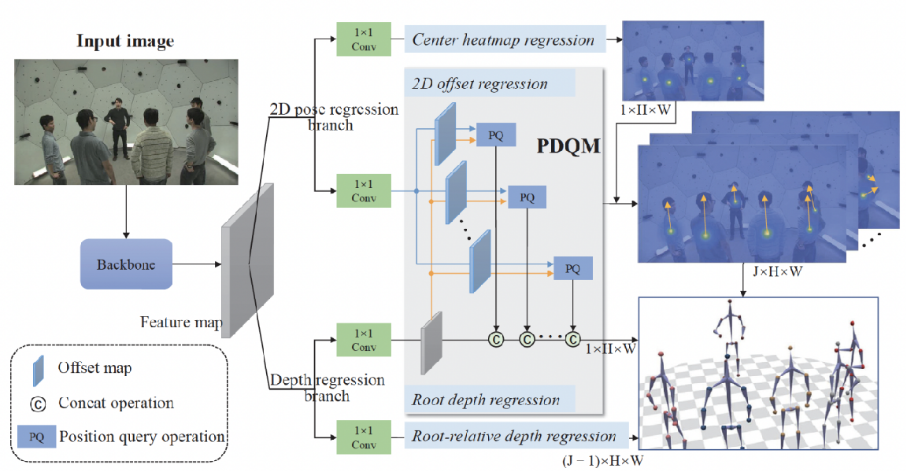
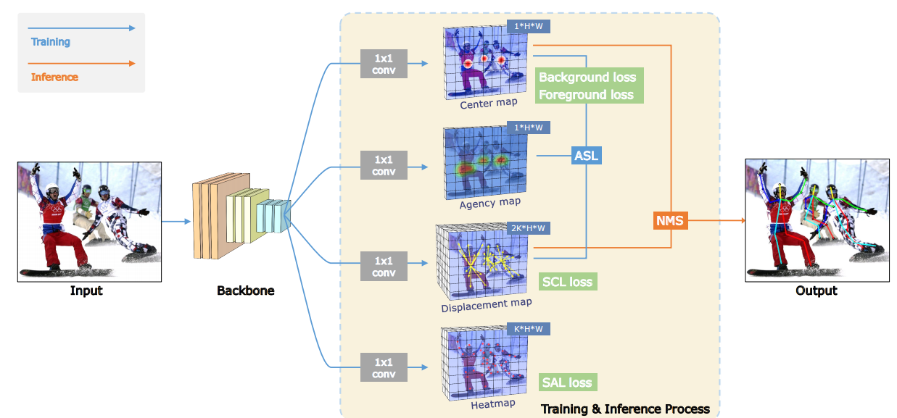
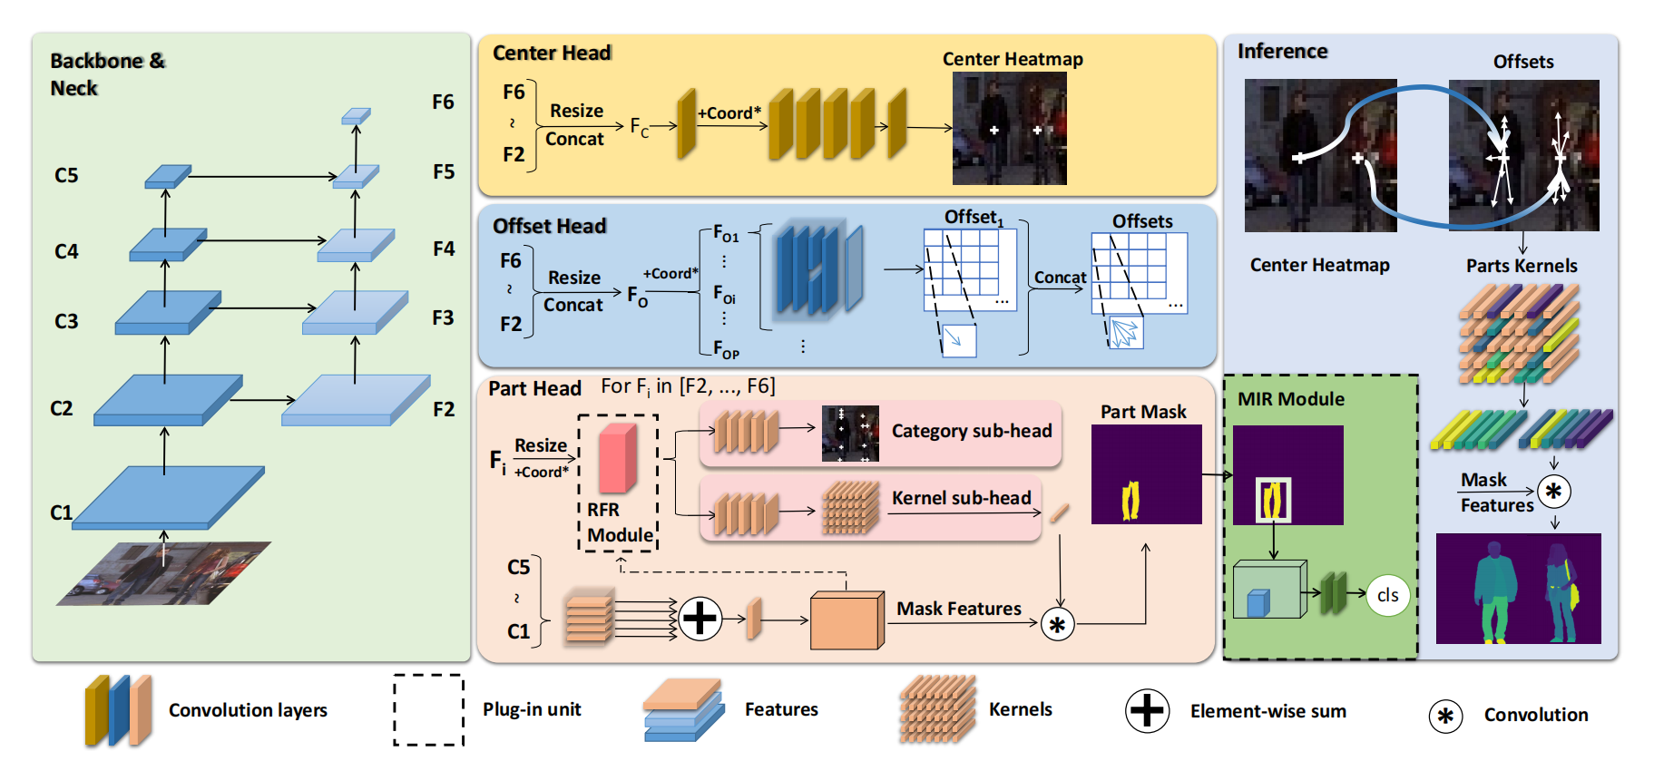
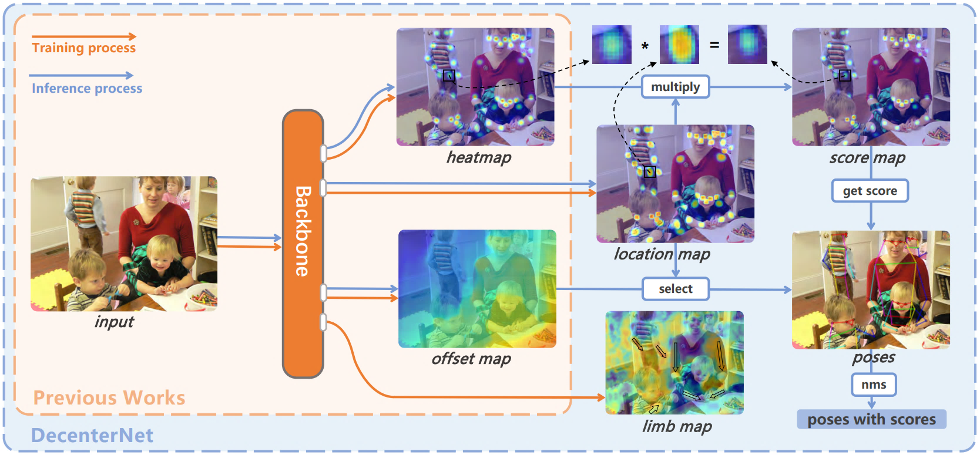
研究背景
多人场景下的单阶段人体实例感知框架
SCHOOL OF ELECTRONIC ENGINEERING BUPT

Slide 6
目录
研究背景
UniParser 多人人体解析算法
单阶段人体姿态估计算法
人体姿态序列优化算法
后续研究
SCHOOL OF ELECTRONIC ENGINEERING BUPT

Slide 7
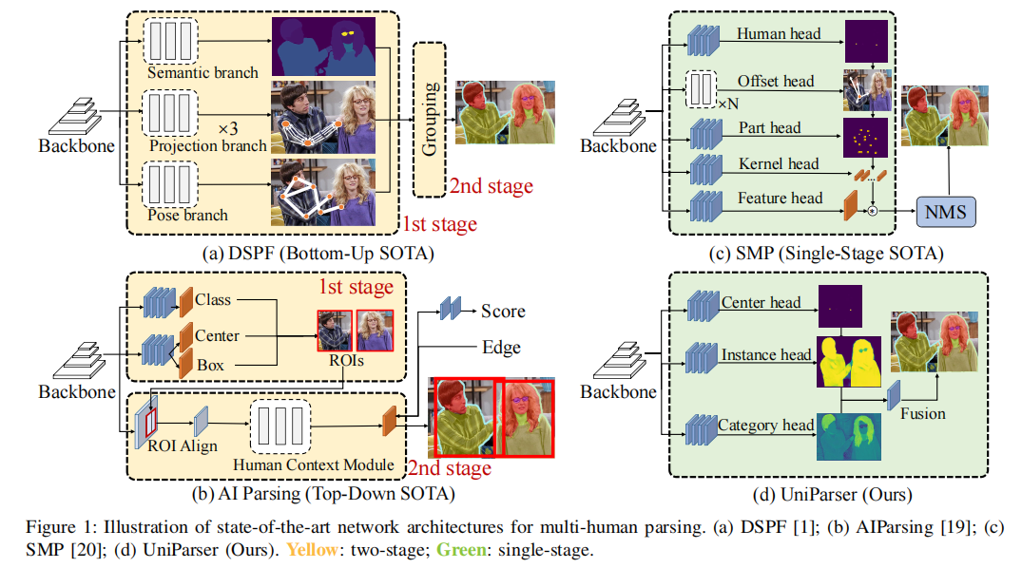
UniParser 多人人体解析算法
动机
Instance信息和Category信息分开处理，从而导致低效率和冗余的处理流程。
J. Chu, L. Jin, Y. Teng, J. Li, Y. Wei, Z. Wang, J. Xing et.al., “UniParser: Multi-Human Parsing with Unified Correlation Representation Learning,” in IEEE Transactions on Image Processing, 2024, Early Access.
SCHOOL OF ELECTRONIC ENGINEERING BUPT

Slide 8
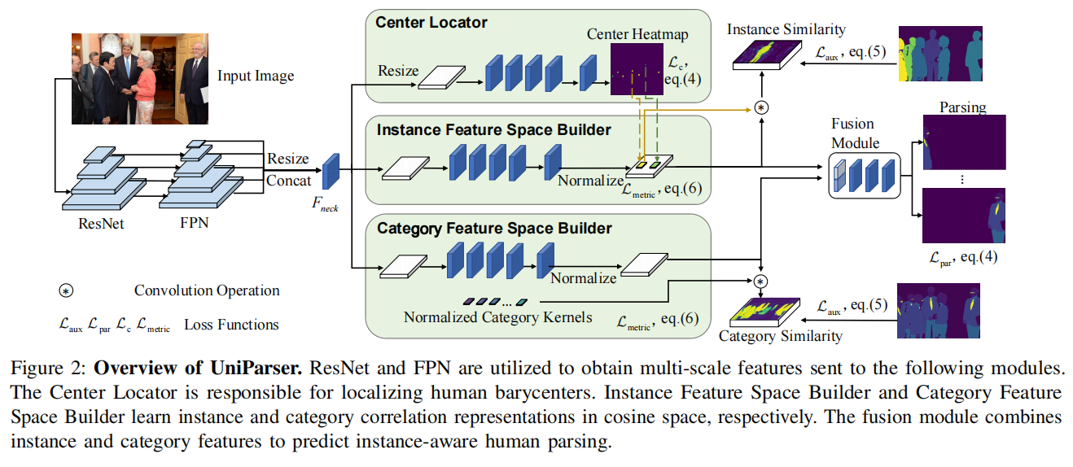
UniParser 多人人体解析算法
Framework
实例级关联表征学习
类别级关联表征学习
J. Chu, L. Jin, Y. Teng, J. Li, Y. Wei, Z. Wang, J. Xing et.al., “UniParser: Multi-Human Parsing with Unified Correlation Representation Learning,” in IEEE Transactions on Image Processing, 2024, Early Access.
SCHOOL OF ELECTRONIC ENGINEERING BUPT

Slide 9
UniParser 多人人体解析算法
融合方式
J. Chu, L. Jin, Y. Teng, J. Li, Y. Wei, Z. Wang, J. Xing et.al., “UniParser: Multi-Human Parsing with Unified Correlation Representation Learning,” in IEEE Transactions on Image Processing, 2024, Early Access.
SCHOOL OF ELECTRONIC ENGINEERING BUPT

Slide 10
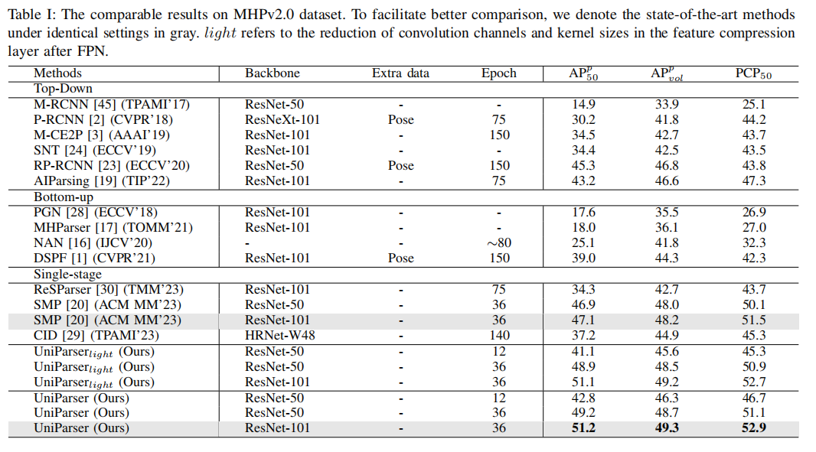
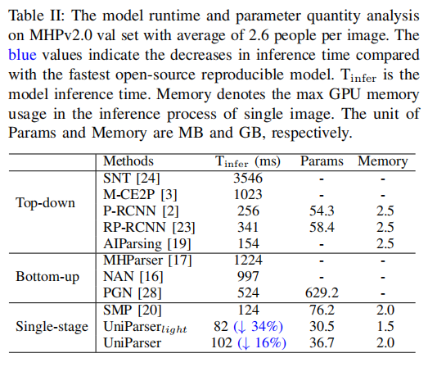
UniParser 多人人体解析算法
实验结果
J. Chu, L. Jin, Y. Teng, J. Li, Y. Wei, Z. Wang, J. Xing et.al., “UniParser: Multi-Human Parsing with Unified Correlation Representation Learning,” in IEEE Transactions on Image Processing, 2024, Early Access.
SCHOOL OF ELECTRONIC ENGINEERING BUPT

Slide 11
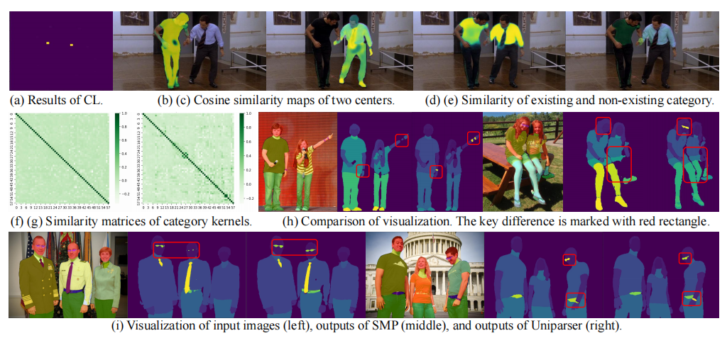
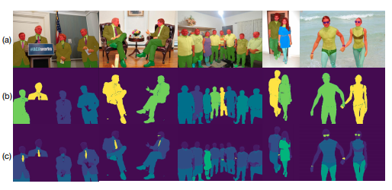
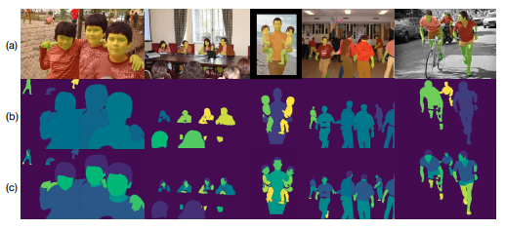
UniParser 多人人体解析算法
可视化结果
J. Chu, L. Jin, Y. Teng, J. Li, Y. Wei, Z. Wang, J. Xing et.al., “UniParser: Multi-Human Parsing with Unified Correlation Representation Learning,” in IEEE Transactions on Image Processing, 2024, Early Access.
SCHOOL OF ELECTRONIC ENGINEERING BUPT

Slide 12
目录
研究背景
UniParser 多人人体解析算法
单阶段人体姿态估计算法
人体姿态序列优化算法
后续研究
SCHOOL OF ELECTRONIC ENGINEERING BUPT

Slide 13
单阶段人体姿态估计算法
· More time consumption
· More computational resources
· More accurate
任务目标
3x
Top-down methods:
Network
1x
Bottom-up methods:
Network
· Run fast
· Running time is predictable
· Lower resource consumption
T. Wang, L. Jin, Z. Wang, X. Fan, Y. Cheng, Y. Teng, J. Xing, and J. Zhao, “Decenternet: Bottom-up human pose estimation via decentralized pose representation,” in ACM MM, 2023, pp. 1798–1808
SCHOOL OF ELECTRONIC ENGINEERING BUPT

Slide 14
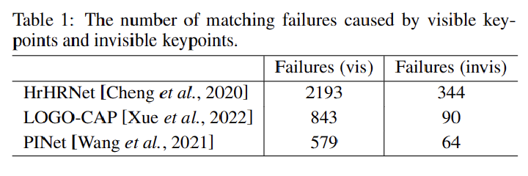
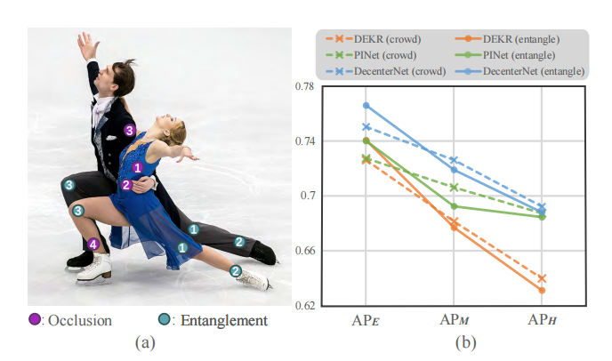
单阶段人体姿态估计算法
动机
Oclussion: 相互交叠部分不可见点。
Entanglement: 相互交叠部分可见点。
T. Wang, L. Jin, Z. Wang, X. Fan, Y. Cheng, Y. Teng, J. Xing, and J. Zhao, “Decenternet: Bottom-up human pose estimation via decentralized pose representation,” in ACM MM, 2023, pp. 1798–1808
SCHOOL OF ELECTRONIC ENGINEERING BUPT

Slide 15
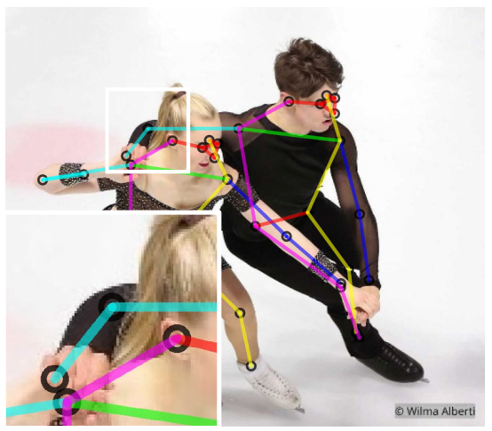
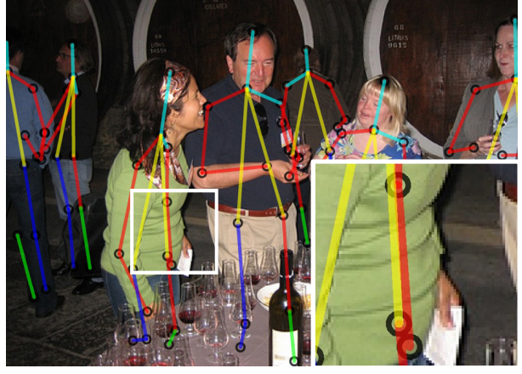
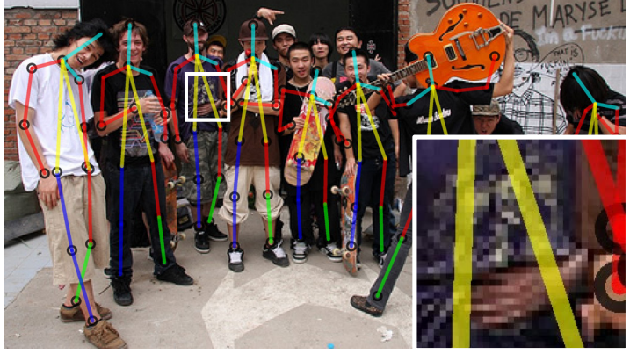
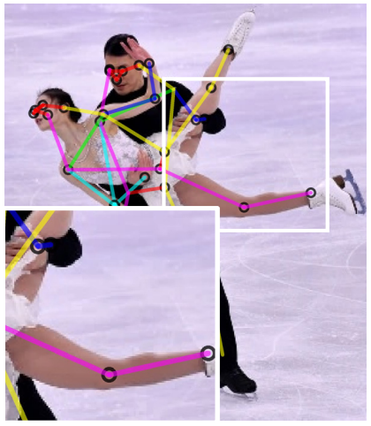
单阶段人体姿态估计算法
单阶段人体姿态表征
所有可见点中心
骨盆
分组中心
所有可见点
T. Wang, L. Jin, Z. Wang, X. Fan, Y. Cheng, Y. Teng, J. Xing, and J. Zhao, “Decenternet: Bottom-up human pose estimation via decentralized pose representation,” in ACM MM, 2023, pp. 1798–1808
SCHOOL OF ELECTRONIC ENGINEERING BUPT

Slide 16
单阶段人体姿态估计算法
DecenterNet整体架构
T. Wang, L. Jin, Z. Wang, X. Fan, Y. Cheng, Y. Teng, J. Xing, and J. Zhao, “Decenternet: Bottom-up human pose estimation via decentralized pose representation,” in ACM MM, 2023, pp. 1798–1808
SCHOOL OF ELECTRONIC ENGINEERING BUPT

Slide 17
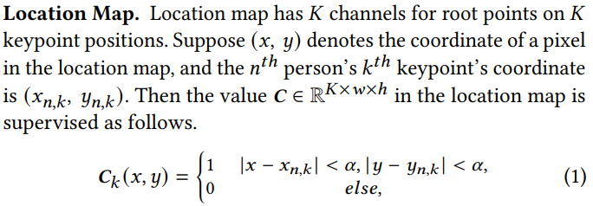
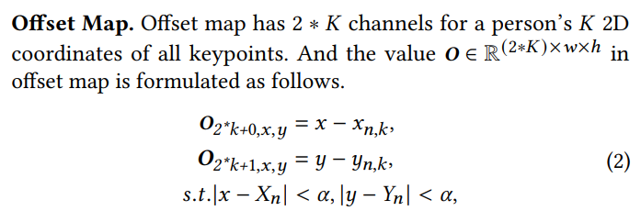
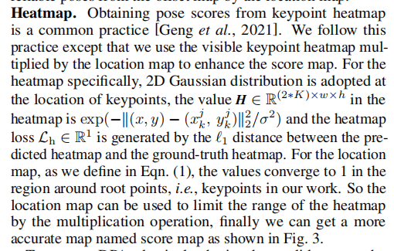
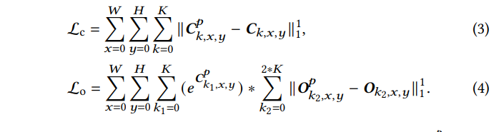
单阶段人体姿态估计算法
解耦姿态评估
Location Map
Offset Map
Heatmap
联合训练
T. Wang, L. Jin, Z. Wang, X. Fan, Y. Cheng, Y. Teng, J. Xing, and J. Zhao, “Decenternet: Bottom-up human pose estimation via decentralized pose representation,” in ACM MM, 2023, pp. 1798–1808
SCHOOL OF ELECTRONIC ENGINEERING BUPT

Slide 18
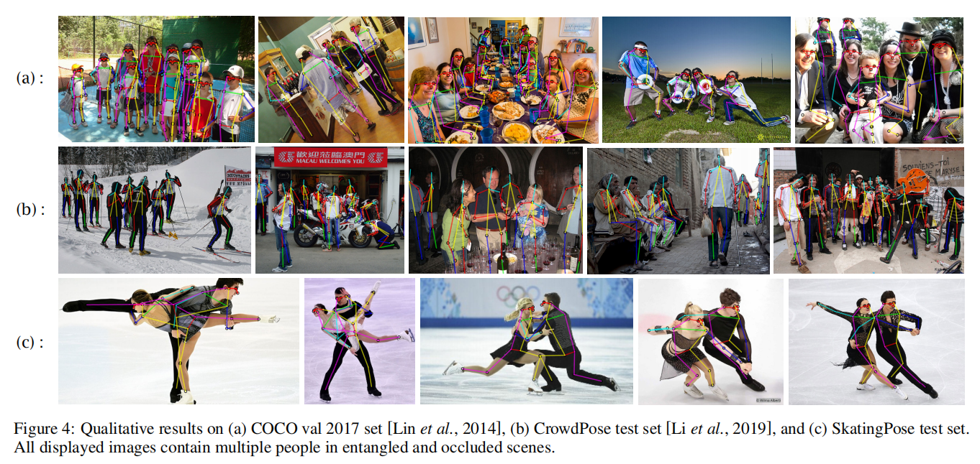
单阶段人体姿态估计算法
数据集搭建
T. Wang, L. Jin, Z. Wang, X. Fan, Y. Cheng, Y. Teng, J. Xing, and J. Zhao, “Decenternet: Bottom-up human pose estimation via decentralized pose representation,” in ACM MM, 2023, pp. 1798–1808
SCHOOL OF ELECTRONIC ENGINEERING BUPT

Slide 19
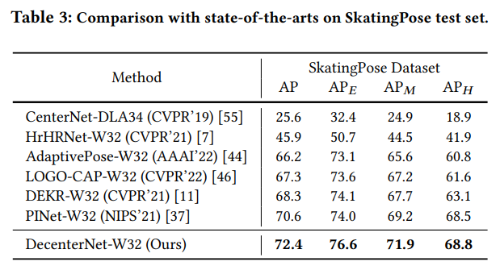
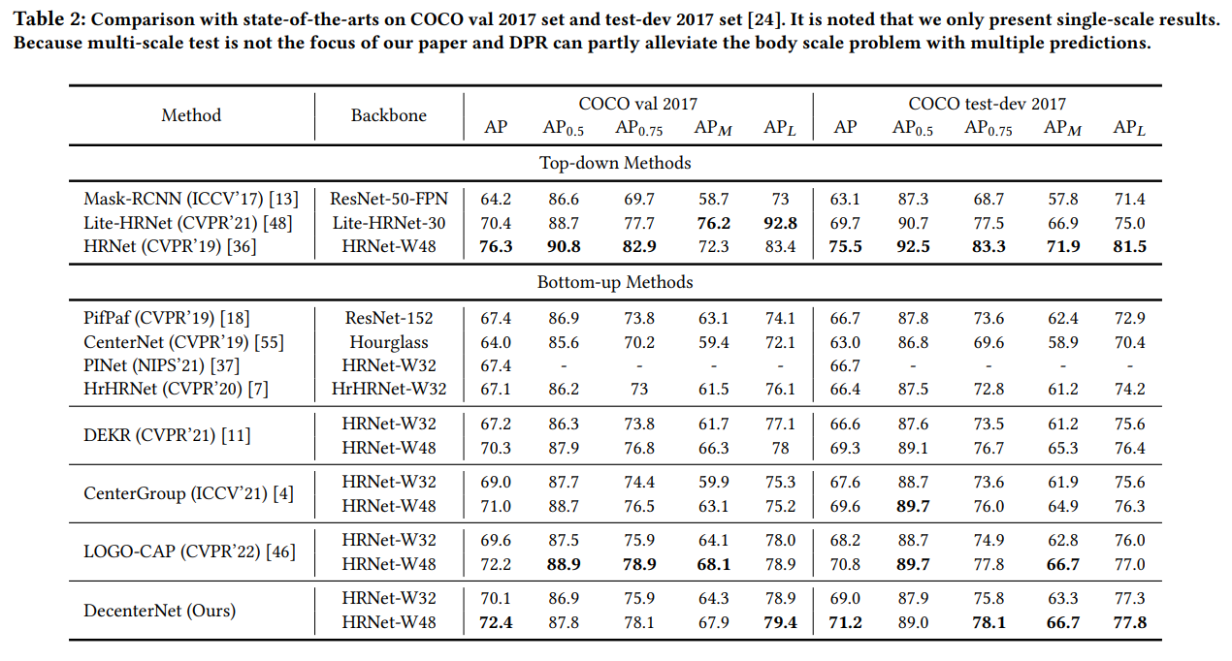
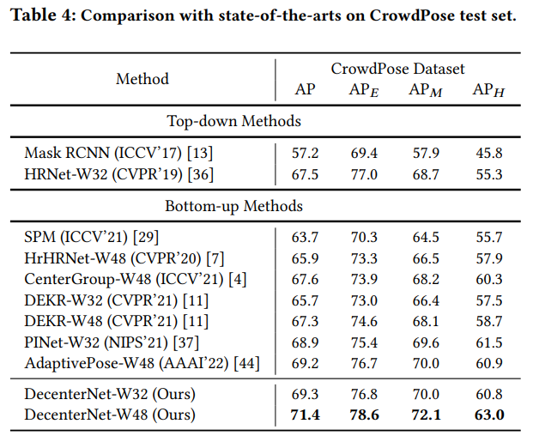
单阶段人体姿态估计算法
实验结果
SCHOOL OF ELECTRONIC ENGINEERING BUPT

Slide 20
目录
研究背景
UniParser 多人人体解析算法
单阶段人体姿态估计算法
人体姿态序列优化算法
后续研究
SCHOOL OF ELECTRONIC ENGINEERING BUPT

Slide 21
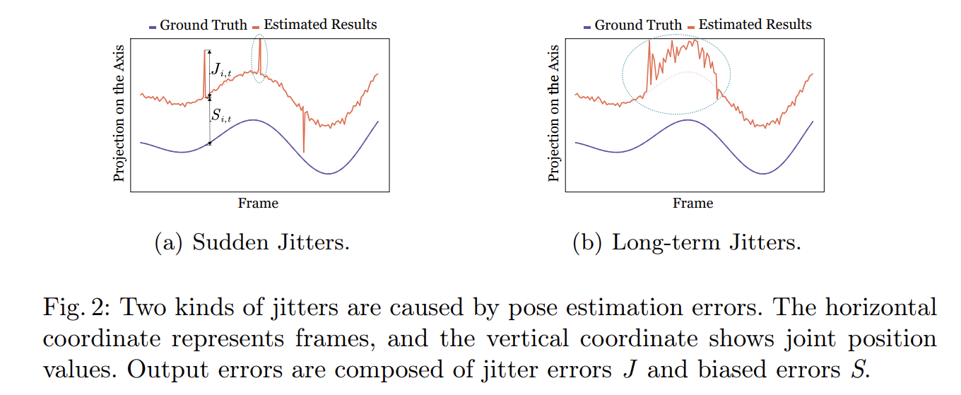
人体姿态序列优化算法
引言
抖动的分类
抖动的原因
轻微抖动：由不可避免的预测小误差和不连续的数据标注导致
剧烈抖动：由低质量图片、罕见姿态或严重遮挡导致
T. Wang, L. Jin, Z. Wang, J. Li, L. Li, F. Zhao, Y. Cheng, L. Yuan, L. Zhou, J. Xing et al., “Synsp: Synergy of smoothness and precision in pose sequences refinement,” in CVPR, 2024.
SCHOOL OF ELECTRONIC ENGINEERING BUPT

Slide 22
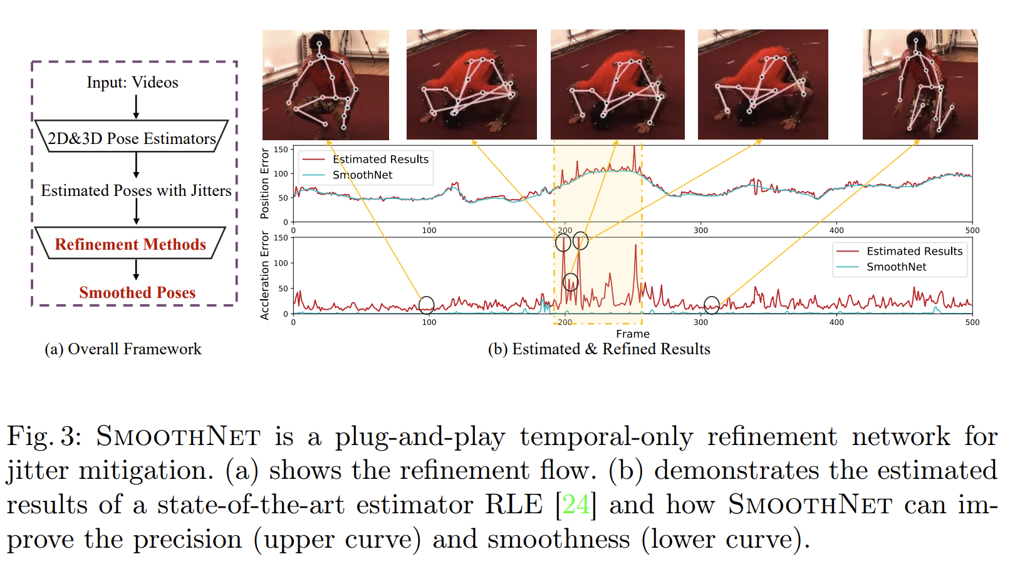
人体姿态序列优化算法
引言
抖动的产生
T. Wang, L. Jin, Z. Wang, J. Li, L. Li, F. Zhao, Y. Cheng, L. Yuan, L. Zhou, J. Xing et al., “Synsp: Synergy of smoothness and precision in pose sequences refinement,” in CVPR, 2024.
SCHOOL OF ELECTRONIC ENGINEERING BUPT

Slide 23
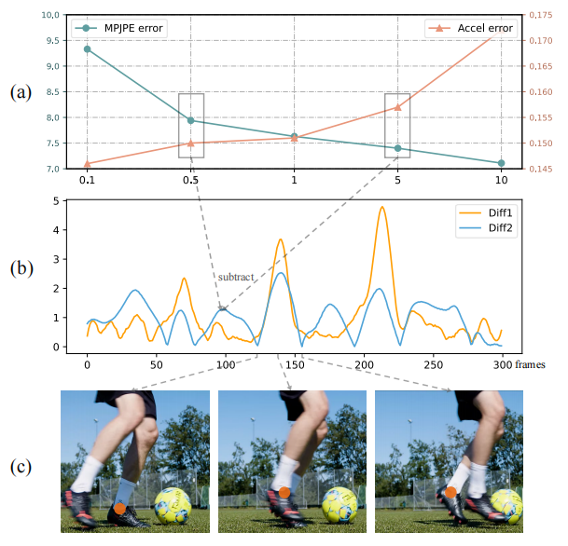
人体姿态序列优化算法
研究动机
精准度和平滑度两者之间存在竞争
Precision objective aims to improve the position accuracy of the predicted joints through the temporal and spatial information, evaluated by Mean Per Joint Position Error
(MPJPE) .
Smoothness objective does not strive to make the output sequences as smooth as possible but rather to align the acceleration of the output with that of the ground-truth sequences.
T. Wang, L. Jin, Z. Wang, J. Li, L. Li, F. Zhao, Y. Cheng, L. Yuan, L. Zhou, J. Xing et al., “Synsp: Synergy of smoothness and precision in pose sequences refinement,” in CVPR, 2024.
SCHOOL OF ELECTRONIC ENGINEERING BUPT

Slide 24
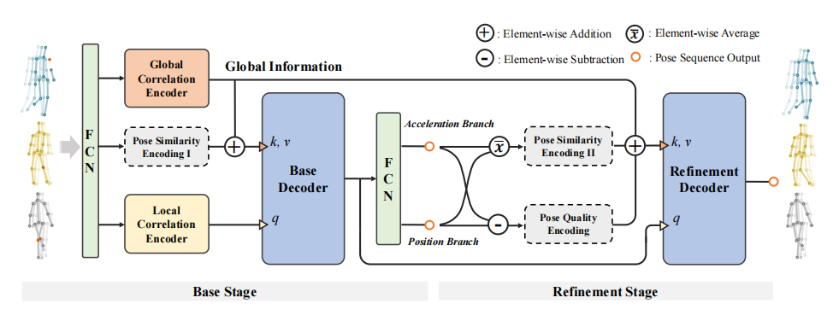
人体姿态序列优化算法
SynSP 网络结构设计
T. Wang, L. Jin, Z. Wang, J. Li, L. Li, F. Zhao, Y. Cheng, L. Yuan, L. Zhou, J. Xing et al., “Synsp: Synergy of smoothness and precision in pose sequences refinement,” in CVPR, 2024.
SCHOOL OF ELECTRONIC ENGINEERING BUPT

Slide 25
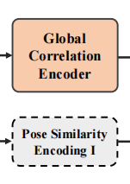
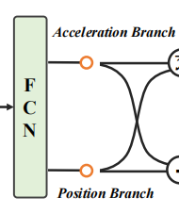
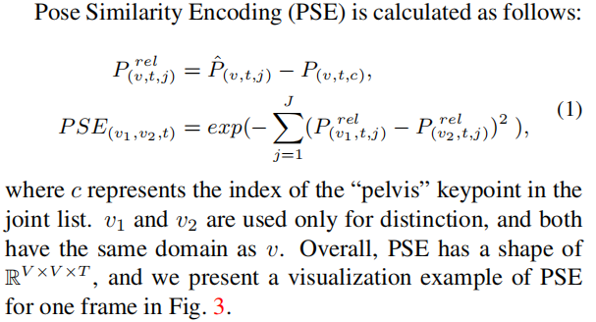
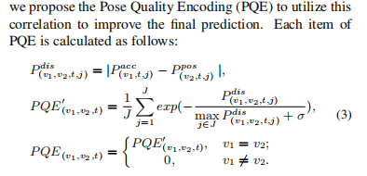
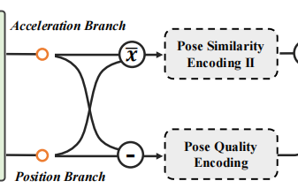
人体姿态序列优化算法
multi-view 多视角输入
双分支输出（pos vs. acc）
姿态相似度编码
姿态质量编码
T. Wang, L. Jin, Z. Wang, J. Li, L. Li, F. Zhao, Y. Cheng, L. Yuan, L. Zhou, J. Xing et al., “Synsp: Synergy of smoothness and precision in pose sequences refinement,” in CVPR, 2024.
SCHOOL OF ELECTRONIC ENGINEERING BUPT

Slide 26
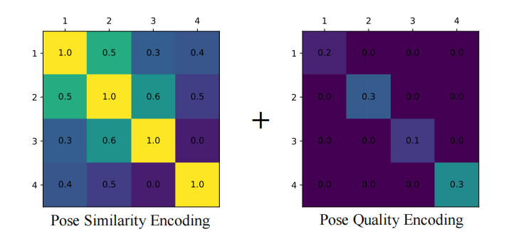
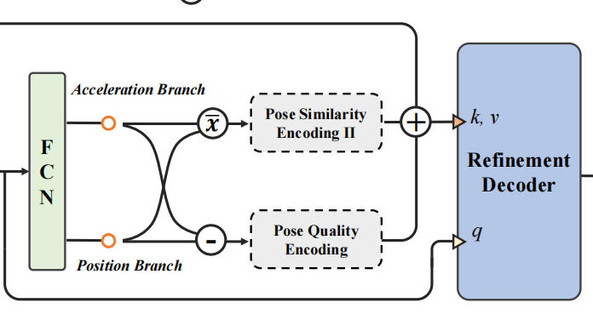
人体姿态序列优化算法
Refine Stage
T. Wang, L. Jin, Z. Wang, J. Li, L. Li, F. Zhao, Y. Cheng, L. Yuan, L. Zhou, J. Xing et al., “Synsp: Synergy of smoothness and precision in pose sequences refinement,” in CVPR, 2024.
SCHOOL OF ELECTRONIC ENGINEERING BUPT

Slide 27
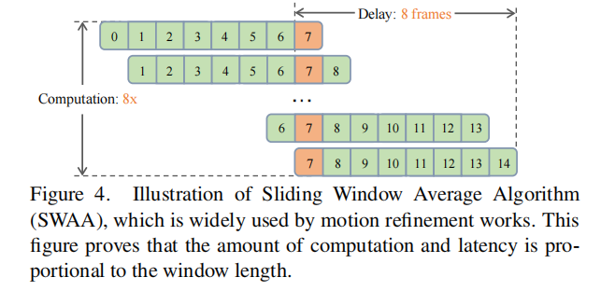
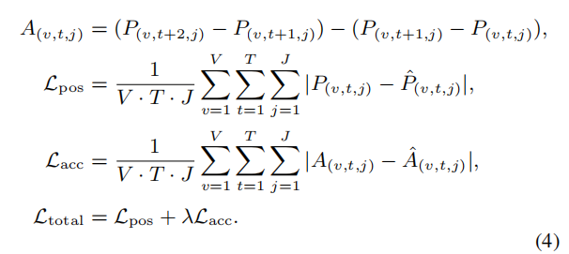
人体姿态序列优化算法
训练与推理
损失函数：
滑动窗口平均：
T. Wang, L. Jin, Z. Wang, J. Li, L. Li, F. Zhao, Y. Cheng, L. Yuan, L. Zhou, J. Xing et al., “Synsp: Synergy of smoothness and precision in pose sequences refinement,” in CVPR, 2024.
SCHOOL OF ELECTRONIC ENGINEERING BUPT

Slide 28
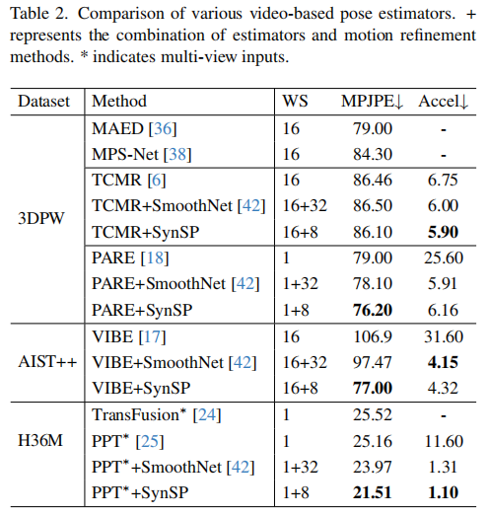
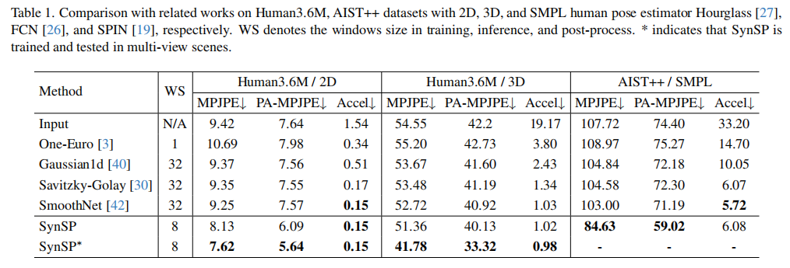
人体姿态序列优化算法
实验结果
在四个公开数据集上取得sota, i.e., Human3.6M, AIST++, 3DPW, CMU-Mocap
T. Wang, L. Jin, Z. Wang, J. Li, L. Li, F. Zhao, Y. Cheng, L. Yuan, L. Zhou, J. Xing et al., “Synsp: Synergy of smoothness and precision in pose sequences refinement,” in CVPR, 2024.
SCHOOL OF ELECTRONIC ENGINEERING BUPT

Slide 29
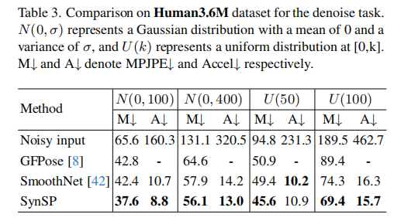
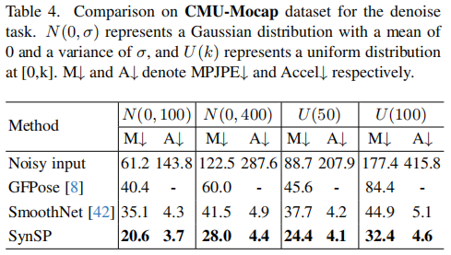
人体姿态序列优化算法
实验结果
在四个公开数据集上取得sota, i.e., Human3.6M, AIST++, 3DPW, CMU-Mocap
T. Wang, L. Jin, Z. Wang, J. Li, L. Li, F. Zhao, Y. Cheng, L. Yuan, L. Zhou, J. Xing et al., “Synsp: Synergy of smoothness and precision in pose sequences refinement,” in CVPR, 2024.
SCHOOL OF ELECTRONIC ENGINEERING BUPT

Slide 30
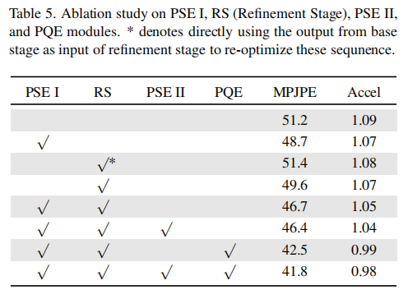
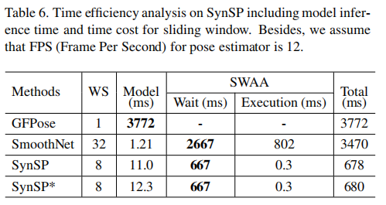
人体姿态序列优化算法
实验结果
消融实验
时间分析
T. Wang, L. Jin, Z. Wang, J. Li, L. Li, F. Zhao, Y. Cheng, L. Yuan, L. Zhou, J. Xing et al., “Synsp: Synergy of smoothness and precision in pose sequences refinement,” in CVPR, 2024.
SCHOOL OF ELECTRONIC ENGINEERING BUPT

Slide 31
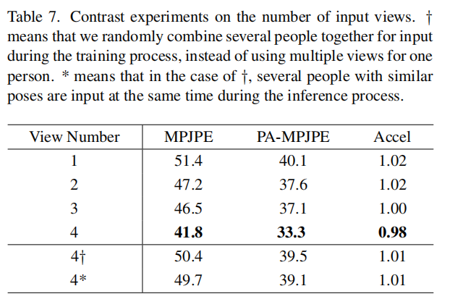
人体姿态序列优化算法
进一步改进
SynSP++: General Pose Sequences Refinement via Synergy of Smoothness and Precision
姿态向量库：Pose Vector Database
SCHOOL OF ELECTRONIC ENGINEERING BUPT

Slide 32
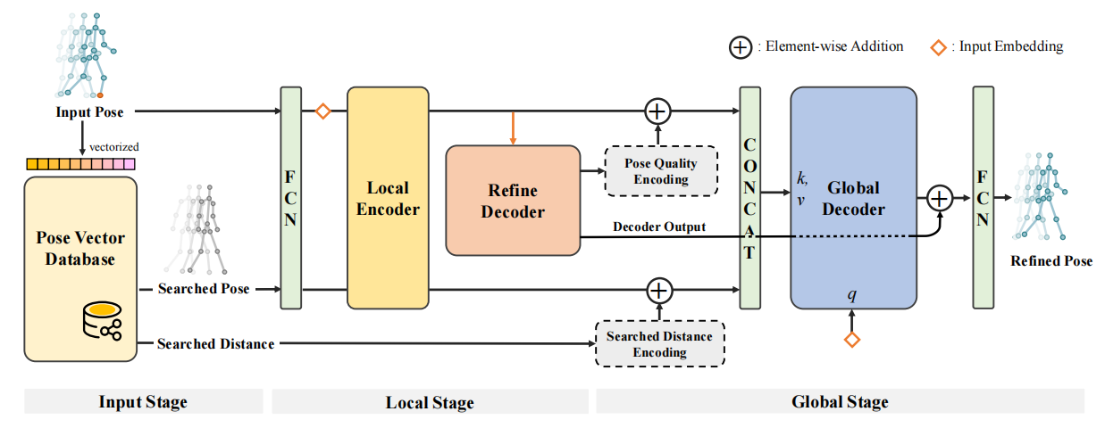
人体姿态序列优化算法
改进网络结构
SCHOOL OF ELECTRONIC ENGINEERING BUPT

Slide 33
人体姿态序列优化算法
姿态向量库构建：
1.构建模板姿态，去除不重要的关键点，如手指，眼睛。
2.时序维度降采样。
3.对齐并归一化。
4.插入向量库。
训练：
挑选最相似的前三个姿态序列，随机插入。
测试：
直接选用最相似的姿态序列。
SCHOOL OF ELECTRONIC ENGINEERING BUPT

Slide 34
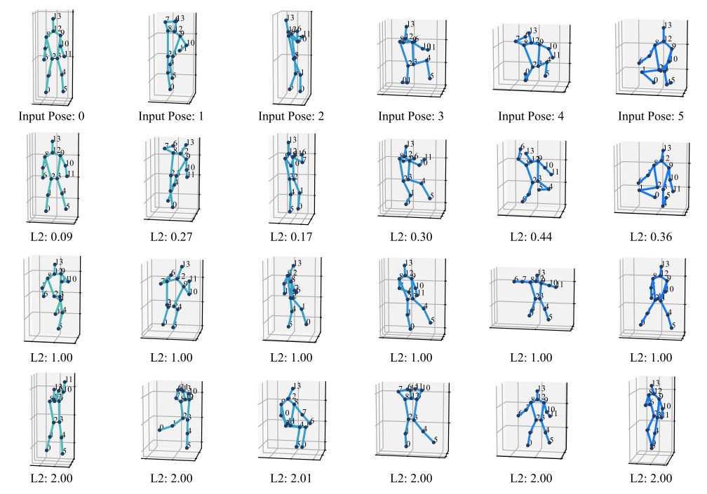
人体姿态序列优化算法
搜索姿态
SCHOOL OF ELECTRONIC ENGINEERING BUPT

Slide 35
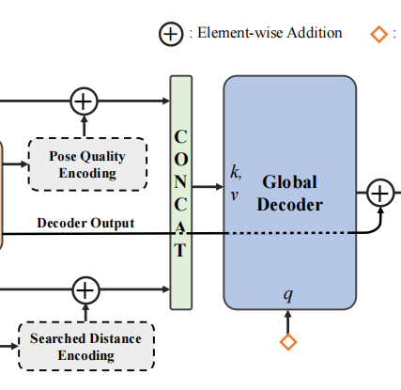
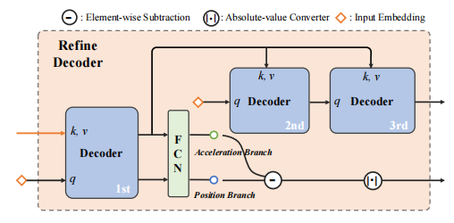
人体姿态序列优化算法
Refine Decoder：
融合方式：
Synergy of Smoothness and Precision
融合姿态质量信息
和参考姿态信息。
SCHOOL OF ELECTRONIC ENGINEERING BUPT

Slide 36
人体姿态序列优化算法
实验结果
相比于单视角的SynSP结果均有显著提升。
SCHOOL OF ELECTRONIC ENGINEERING BUPT

Slide 37
人体姿态序列优化算法
实验结果
相比于单视角的SynSP结果均有显著提升。
SCHOOL OF ELECTRONIC ENGINEERING BUPT

Slide 38
人体姿态序列优化算法
实验结果
消融实验
时间分析
SCHOOL OF ELECTRONIC ENGINEERING BUPT

Slide 39
目录
研究背景
UniParser 多人人体解析算法
单阶段人体姿态估计算法
人体姿态序列优化算法
后续研究
SCHOOL OF ELECTRONIC ENGINEERING BUPT

Slide 40
后续研究
text-to-motion
SCHOOL OF ELECTRONIC ENGINEERING BUPT

Slide 41
后续研究
4D Avatar
SCHOOL OF ELECTRONIC ENGINEERING BUPT

